Slide 1


Cloud Computing
G Ambrish
This Photo by Unknown Author is licensed under CC BY-SA-NC

Slide 2
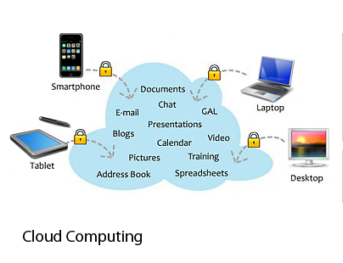
Introduction
Cloud computing is the delivery of computing services including servers, storages, databases, networking, software, analytics and intelligence – over the Internet to offer faster innovation, flexible resources and economic of scale.
Example : AWS, Azure, Google Cloud
This Photo by Unknown Author is licensed under CC BY-NC

Slide 3
Why Cloud Computing
With increase in computer and Mobile user’s, data storage has become a priority in all fields.

Slide 4

Top Benefits of cloud computing
Cost : cloud computing eliminates the capital expense of buying hardware and software and setting up and running on-site data centres – racks of servers the round-the-clock electricity for power and cooling, the IT experts for managing the infrastructure.
This Photo by Unknown Author is licensed under CC BY-NC-ND

Slide 5

Top Benefits of cloud computing
Speed: Most cloud computing services are provided self service and on demand, so even vast amount of computing resources can be provisioned in minutes, typically within few mouse clicks, giving business lot of flexibility and taking the pressure of capability planning.
This Photo by Unknown Author is licensed under CC BY-NC-ND

Slide 6

Top Benefits of cloud computing
Global Scale: the benefits of cloud computing service includes the ability to scale elastically. In cloud speak, that means delivering the right amount of IT resources. Example Storage bandwidth, more or less computing power – right when it is needed from the right geographic location.
This Photo by Unknown Author is licensed under CC BY-SA

Slide 7
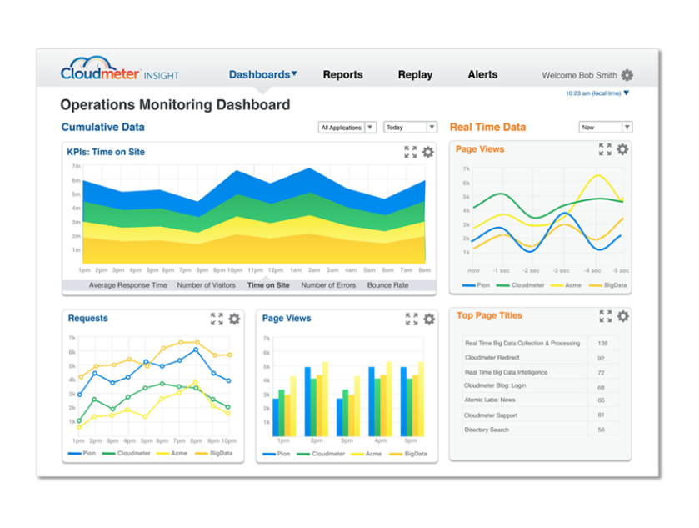
Top Benefits of cloud computing
Performance: The biggest cloud computing service run on a world wide network of secure datacentres, which are regularly updated to the latest generation of fast and efficient computing hardware.
This Photo by Unknown Author is licensed under CC BY-SA-NC

Slide 8

Top Benefits of cloud computing
Security: Many cloud providers offers a broad set of policies, technologies and controls that strengthens your security posture overall, helping protects your data, apps and infrastructures from potential threats.

Slide 9

Top Benefits of cloud computing
Productivity: on-site datacentres typically requires a lot of “racking and stacking”. Hardware setup, software patching and other time consuming IT management chores. Cloud computing removes the need for many of these tasks, so IT team can speed time on achieving more important business goals.
This Photo by Unknown Author is licensed under CC BY-SA-NC

Slide 10
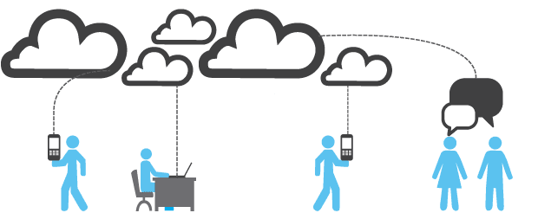
Top Benefits of cloud computing
Reliability : Cloud computing makes data backup and distractor recover and business continuity easier and less expensive because data can be mirrored at multiple redundant sites on the cloud providers networks.
This Photo by Unknown Author is licensed under CC BY-NC-ND

Slide 11
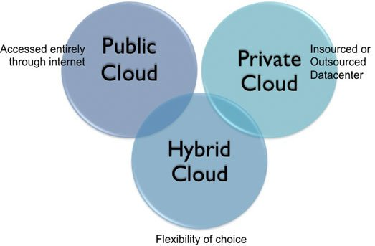
Types of Cloud Computing
This Photo by Unknown Author is licensed under CC BY-SA-NC

Slide 12
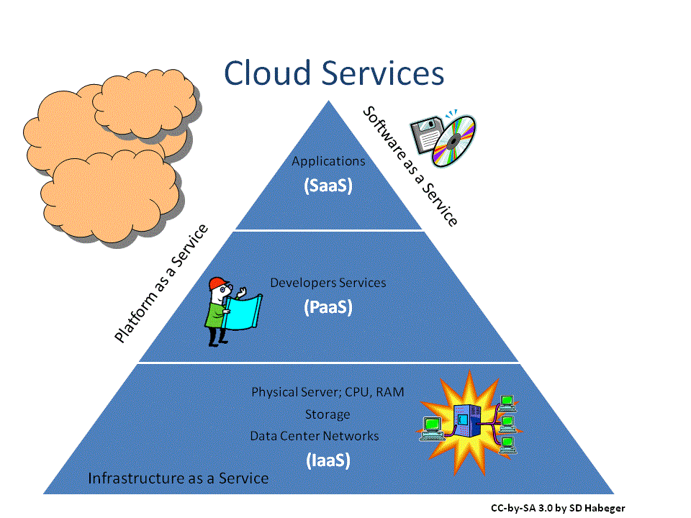
Types of Cloud Services
This Photo by Unknown Author is licensed under CC BY-SA-NC
This Photo by Unknown Author is licensed under CC BY-NC-ND

Slide 13
Uses of Cloud Computing
Create Cloud Native Application
Store, Backup and recover data.
stream audio and video.
Deliver software on demand.
Test and Build Application.
Analyses data.
Embed intelligence.

Slide 14
Application of Cloud Computing

Slide 15


Slide 16

This Photo by Unknown Author is licensed under CC BY-NC

